Slide 1


Economic outlook: The Netherlands
Koen Rolleman
Principles of Macroeconomics
ECON 211A SP22
Professor Biwei Chen
Koen.rolleman24@houghton.edu
Houghton College

Slide 2
Table of contents
3- GDP
4- GDP growth and inflation
5- Interest rate
6- Foreign investment
7- Unemployment
8- Im- and exports
9- CO2 emmisions
10- citations

Slide 3
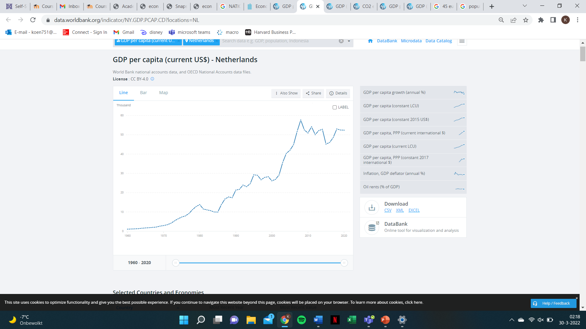
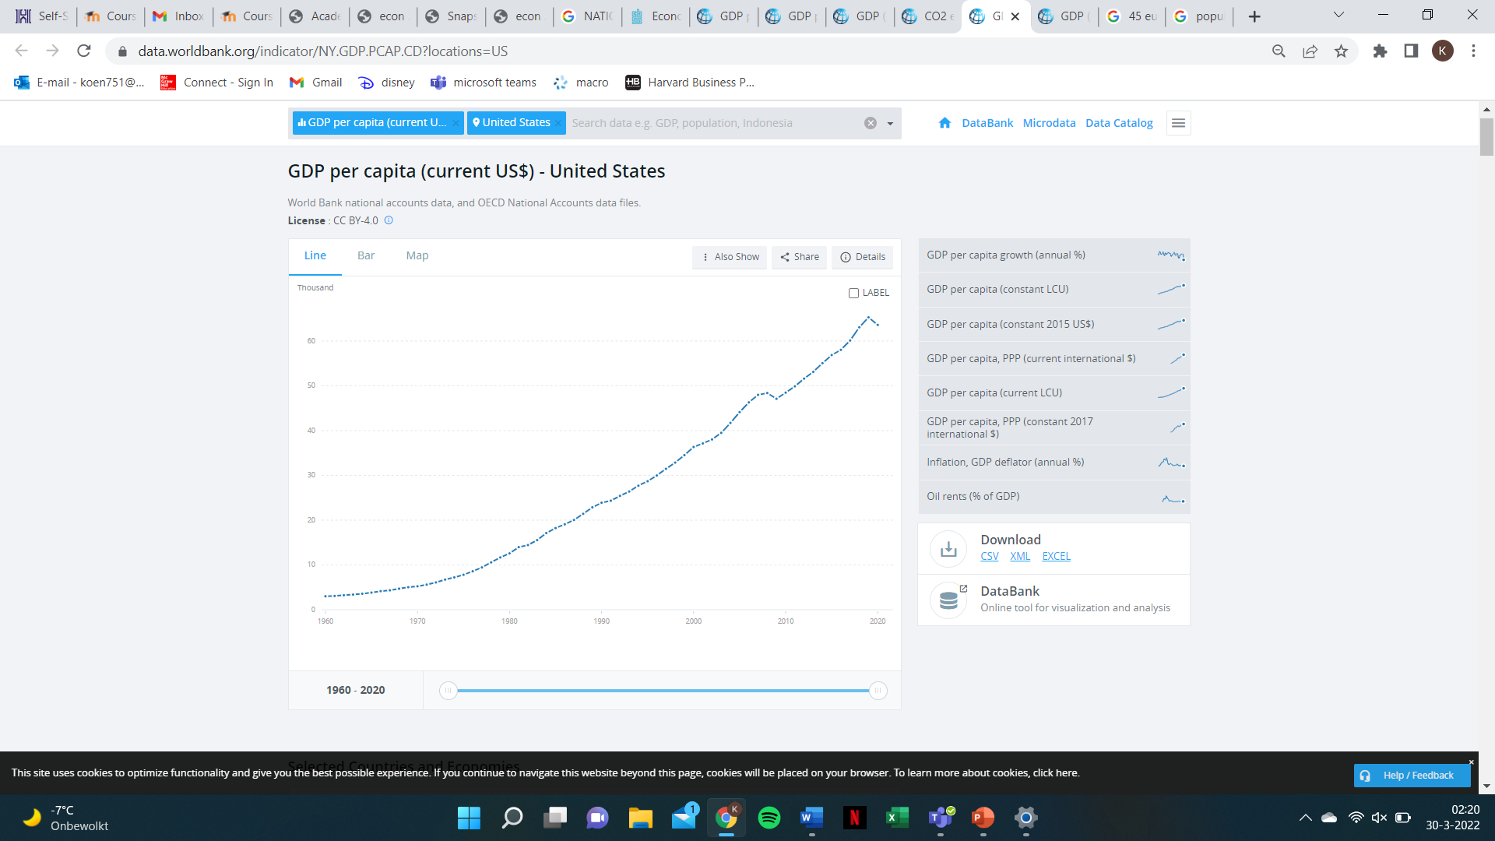
GDP numbers compared to US
Use of Euro (worth about 1.1 US dollar)
Population the Netherlands: 17.4 million population USA: 329.5 million
current GDP (2020) Netherlands: 913.5 billion USA: 21 trillion
current GDP per capita (2020) Netherlands: 52.4 thousand USA: 63.6 thousand

Slide 4
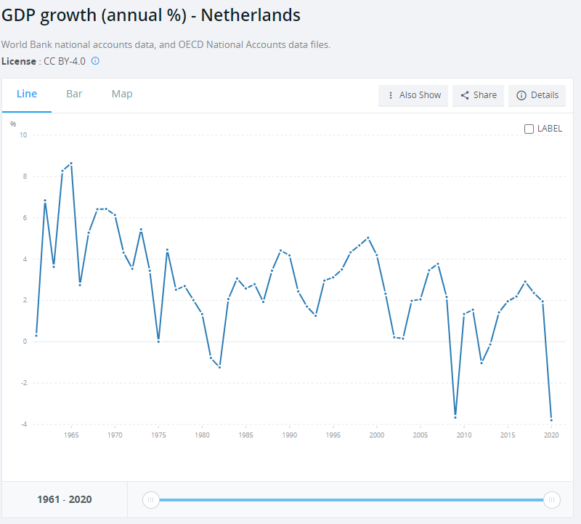
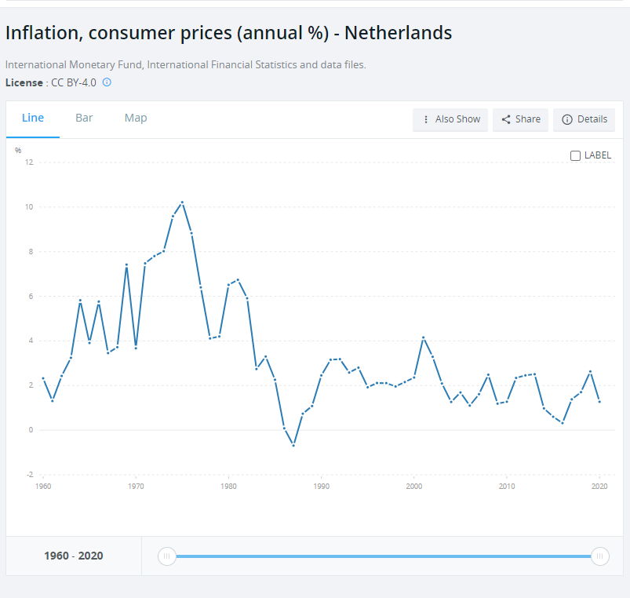
GDP growth and inflation

Slide 5
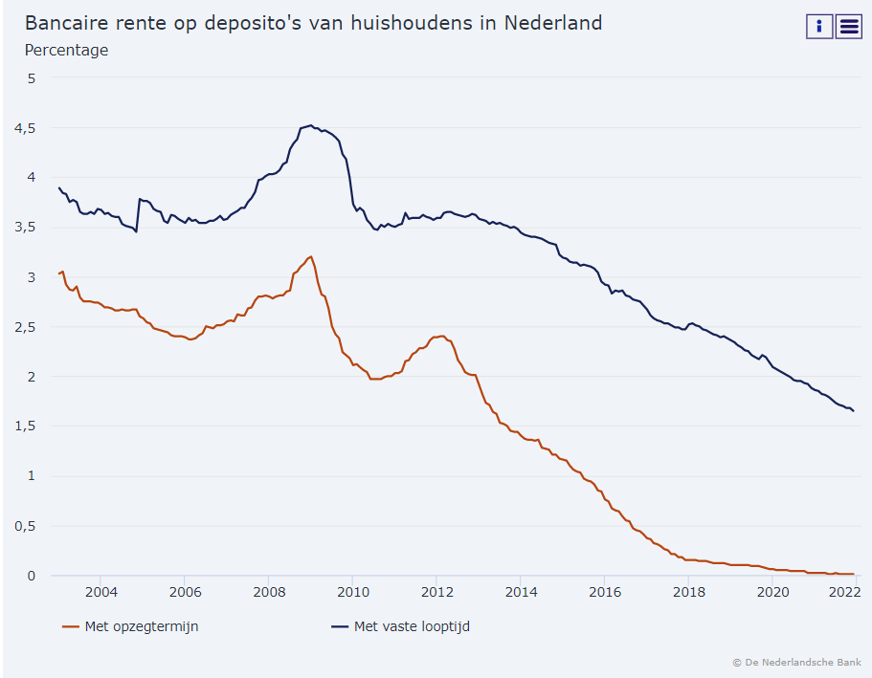
Interest rate

Slide 6
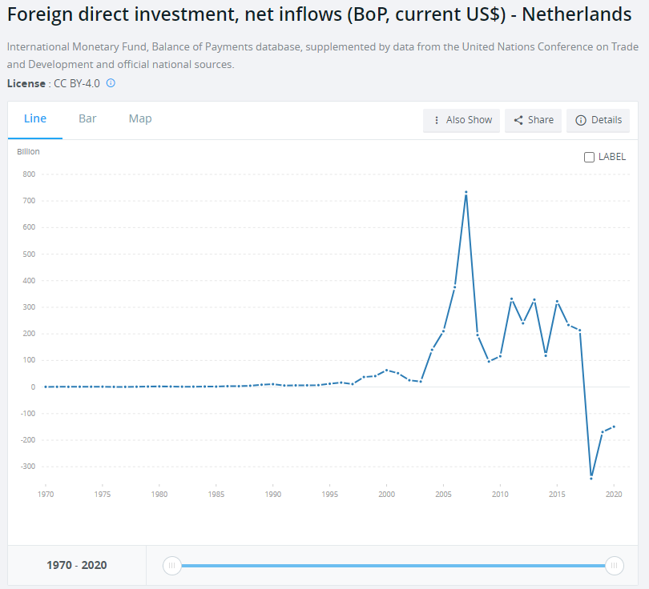
Foreign investment

Slide 7
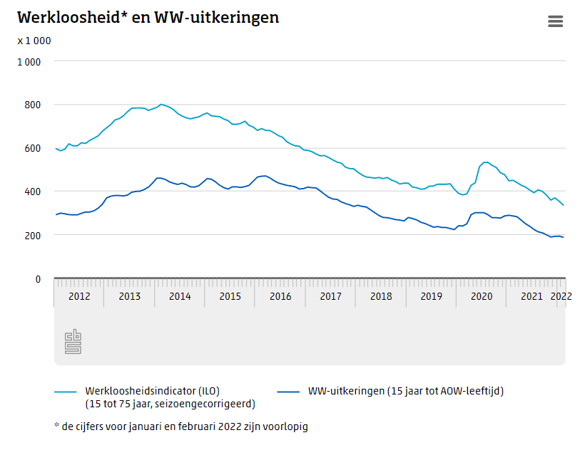
Unemployment

Slide 8
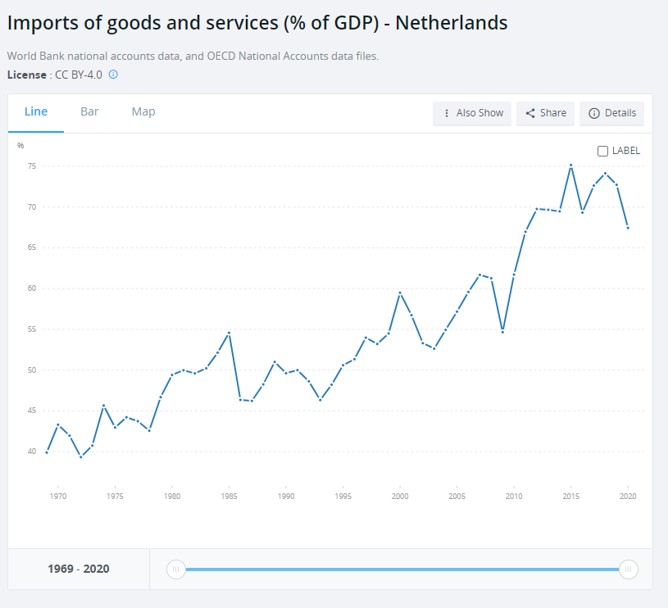
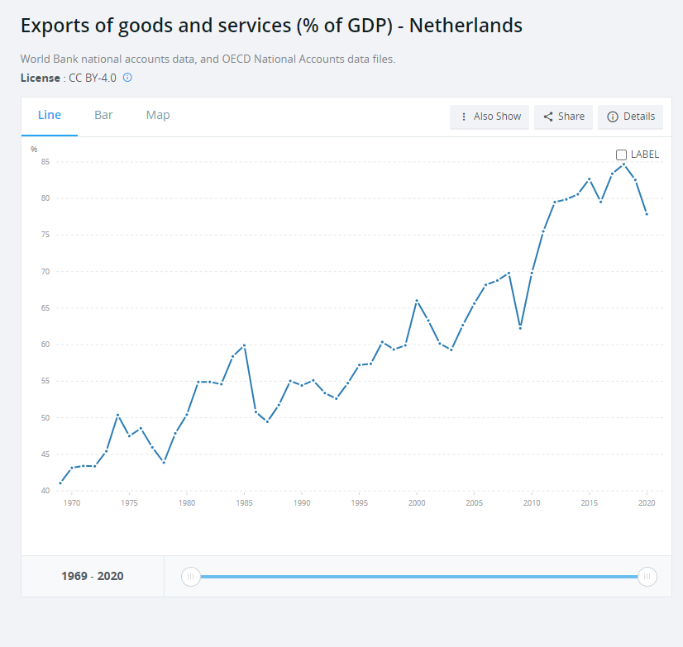
Im- and exports

Slide 9
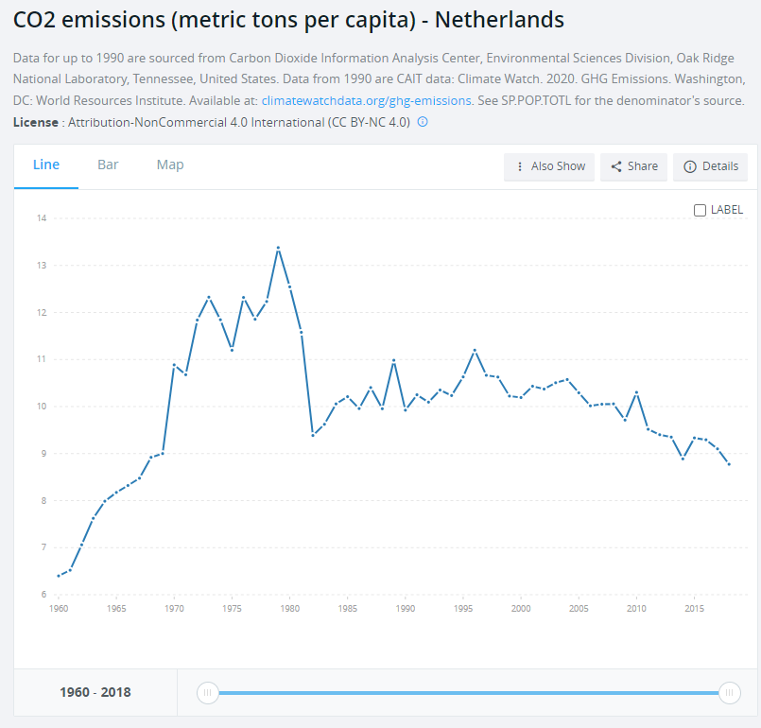
CO2 emmisions per capita

Slide 10
Citations
“Netherlands.” World Bank, https://data.worldbank.org/country/netherlands
“USA.” World Bank, https://data.worldbank.org/country/united-states
Centraal Bureau voor de Statistiek. “Werkloosheid in Februari Verder Afgenomen.” Centraal Bureau Voor De Statistiek, Centraal Bureau Voor De Statistiek, 17 Mar. 2022, https://www.cbs.nl/nl-nl/nieuws/2022/11/werkloosheid-in-februari-verder-afgenomen.

